Slide 1
Greedy: knapsack, disjoint sets, mst & shortest path
Session 11
Henry Lucky, S.Kom., M.Kom.

Slide 2
Learning Outcomes
Session 11
At the end of this session, students will be able to:
LO 2: Analyze unfamiliar computational problems by identifying their structural properties, classifying them into known algorithmic categories including graph, string, and combinatorial problems and recommending a solution strategy with justification.
LO 3: Design solutions to unfamiliar computational problems by selecting and applying appropriate strategies including Divide and Conquer, Greedy, Dynamic Programming, and Backtracking.

Slide 3
Learning Outcomes
Session 11
By the end of this session, students will be able to:
[LO 2] Identify greedy as appropriate for fractional knapsack, MST, and SSSP; classify problems where greedy succeeds vs. fails (0/1 knapsack) by verifying the greedy-choice property; distinguish disjoint-set union as a greedy-supporting data structure.
[LO 3] Design and apply fractional knapsack greedy, Kruskal's and Prim's MST algorithms with Union-Find (path compression + union by rank), and Dijkstra's SSSP; implement DECREASE-KEY for Dijkstra using a min-heap.

Slide 4
outline
Session 11
Greedy Paradigm — When It Works and When It Fails
Fractional Knapsack
Minimum Spanning Tree: Kruskal's and Prim's
Dijkstra's Shortest Path Algorithm

Slide 5
Greedy paradigm
Solution of problems
One of the functions of the algorithm is to solve problems/issues.
A problem could be:
  Having a single set of solutions
  Having multiple sets of solutions that are equally true
  Having multiple sets of solutions with different levels of truth
  Do not have a set of solutions that "total" true, but there are several sets of solutions close to the truth
  Do not have the set of solutions at all

Slide 6
Greedy paradigm
Solution of problems
A problem has:
  Universal solution
    all the possible solutions both right and wrong
  Feasible solution
    all possible correct solutions, but different levels of truth
  Objective function
    the function to measure the solution which is more correct (better)
  Optimal solution
    the most correct solution (best)

Slide 7
Greedy paradigm
Problem solving techniques
Some of the popular techniques in problem solving:
  Greedy method
  Dynamic Programming
  Data compression
  Backtracking
  Branch and Bound

Slide 8
Greedy paradigm
Definition
A greedy algorithm builds a solution incrementally by making the locally optimal (greedy) choice at each step, never revising past decisions.
Algorithms often perform some calculation phase before finding a final solution.
Sometimes these stages produced a number of elements that will be used to formulate the final solution.
Greedy method will "ignore" a complete calculation in the search for solutions, replacing it with using those elements to calculate the solution more quickly.
Very useful if the search for solutions 100% take too long rather than waste time trying to calculate the "best" solution, it is better saved by finding a "good enough" solution.

Slide 9
Greedy paradigm
Definition
When it works: The problem exhibits:
Greedy-choice property: A globally optimal solution can be reached by making a locally optimal choice.
Optimal substructure: The optimal solution to the problem contains optimal solutions to subproblems.
When it doesn’t work:
Simply, when the problem doesn’t exhibit those two properties, especially the Greedy-choice (as many problems exhibit optimal substructure).

Slide 10
Fractional knapsack
Knapsack problem
A thief entered a house. He was carrying a bag with maximum capacity 20 kg. At the house there are items A, B, C, D, E.
  A weighed 7 kg, valued at $ 2975
  B weighed 3 kg, valued at $ 1230
  C weighed 9 kg, valued at $ 3870
  D weighed 2 kg, valued at $ 840
  E weighed 5 kg, valued at $ 2250
What items to bring the thief for getting maximum benefit? (must not exceed the capacity of his bag of 20 kg)

Slide 11
Fractional knapsack
Variation of knapsack problem
Fractional Knapsack Problem
  The items are divisible. You can take any fraction of an item.
  Think of items like gold dust, spices, or liquids, where you can take exactly the amount you can carry.
0/1 Knapsack Problem
  The items are indivisible. You must either take an entire item or leave it behind.
  You cannot take half a laptop or a piece of a television.

Slide 12
Fractional knapsack
Brute force of 0/1 knapsack: all feasible $2^{n}$ solution
Item | Weight | Value |  | Item | Weight | Value
{} | 0 | 0 |  | {A,B,C} | 19 | 8075
{A} | 7 | 2975 |  | {A,B,D} | 12 | 5045
{B} | 3 | 1230 |  | {A,B,E} | 15 | 6455
{C} | 9 | 3870 |  | {A,C,D} | 18 | 7685
{D} | 2 | 840 |  | {A,C,E} | 21 | 9095
{E} | 5 | 2250 |  | {A,D,E} | 14 | 6065
{A,B} | 10 | 4205 |  | {B,C,D} | 14 | 5940
{A,C} | 16 | 6845 |  | {B,C,E} | 17 | 7350
{A,D} | 9 | 3815 |  | {B,D,E} | 10 | 4320
{A,E} | 12 | 5225 |  | {C,D,E} | 16 | 6960
{B,C} | 12 | 5100 |  | {A,B,C,D} | 21 | 8915
{B,D} | 5 | 2070 |  | {A,B,C,E} | 24 | 10325
{B,E} | 8 | 3480 |  | {A,B,D,E} | 17 | 7295
{C,D} | 11 | 4710 |  | {A,C,D,E} | 23 | 9935
{C,E} | 14 | 6120 |  | {B,C,D,E} | 19 | 8190
{D,E} | 7 | 3090 |  | {A,B,C,D,E} | 27 | 11165

Slide 13
Fractional knapsack
Greedy mindset
For now, we will only talk about the fractional variant.
Let's consider how a greedy mindset might approach this problem.
What is the most obvious "locally optimal" choice? Here are a few plausible greedy rules:
  Greedy by Highest Value: Always take the most valuable item available that fits.
  Greedy by Lowest Weight: Always take the lightest item available that fits, to leave more room.
  Greedy by Highest Value Density: Always take the item with the highest value-to-weight ratio (e.g., dollars per kilogram).

Slide 14
Fractional knapsack
Refuting Greedy Rules with Counterexamples
Consider a knapsack with a capacity of 50 kg.
With four items:
  Item A: 20 kg, $20
  Item B: 25 kg, $100
  Item C: 40 kg, $110
  Item D: 15 kg, $10
This is the exact instance that works as counter example for Greedy by Highest Value and Lowest Weight.

Slide 15
Fractional knapsack
Refuting Greedy Rules with Counterexamples
Consider a knapsack with a capacity of 50 kg.
With four items:
  Item A: 20 kg, $20
  Item B: 25 kg, $100
  Item C: 40 kg, $110
  Item D: 15 kg, $10
Greedy by Highest Value would choose C + 10/25 of B ($140)
Greedy by Lowest Weight would choose D, A, and 15/25 of B ($90).

Slide 16
Fractional knapsack
Validating a greedy rule
Now, let’s run the Greedy by Highest Value Density
Knapsack Capacity: 50 kg
Items value density:
  Item A: 20 kg, $20 → $1/kg
  Item B: 25 kg, $100 → $4/kg
  Item C: 40 kg, $110 → $2,75/kg
  Item D: 15 kg, $10 → $0,667/kg
Items sorted by highest density: B ($4/kg), C ($2,75/kg), A ($1/kg), D ($0,667/kg)

Slide 17
Fractional knapsack
Validating a greedy rule
After taking item B (the highest value density), we are left with 50-25 = 15kg capacity.
Therefore, we could take 15/40 of item C (the next highest value density)
Here, we get $100 + 15/40 * $110 = $141,25 with full 50kg total weight.
By taking the highest-density item, we are always making the most efficient use of every kilogram of capacity.
Intuitively, this feels correct. But to be sure, we need a more robust justification than just our gut feeling.
This is where the exchange argument comes in.

Slide 18
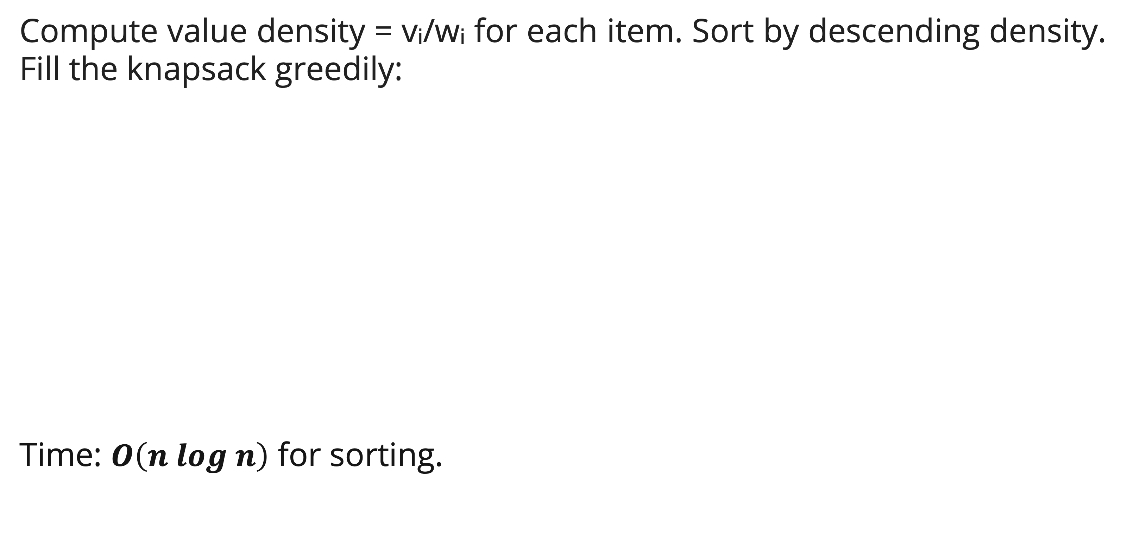
Fractional knapsack
Greedy algorithm
Compute value density = vᵢ/wᵢ for each item. Sort by descending density. Fill the knapsack greedily:
Time: $O\left(n log n\right)$ for sorting.
FRACTIONAL-KNAPSACK(items, W)
sort items by vᵢ/wᵢ descending
total = 0
for each item i in sorted order
if W ≥ wᵢ
take whole item: total += vᵢ; W -= wᵢ
else
take fraction: total += vᵢ × (W/wᵢ); W = 0; break
return total

Slide 19
Fractional knapsack
Exchange argument
The exchange argument is a standard proof technique used to show that a greedy algorithm produces an optimal solution.
The logic goes like this:
  Assume there is some optimal solution that is different from our greedy solution.
  We will show that we can transform that optimal solution into our greedy one without decreasing its total value, thus proving that the greedy solution is itself optimal.

Slide 20
Fractional knapsack
Exchange argument: Step 1 – Assume an Optimal Solution Exists
Let G be the solution produced by our greedy algorithm.
Assume there is an optimal solution O that is different from G.
Our goal is to show that the total value of O cannot be strictly greater than the total value of G (V(O) ≤ V(G)).
Because if total value of O is more than G, then our greedy algorithm failed to find the optimal solution.

Slide 21
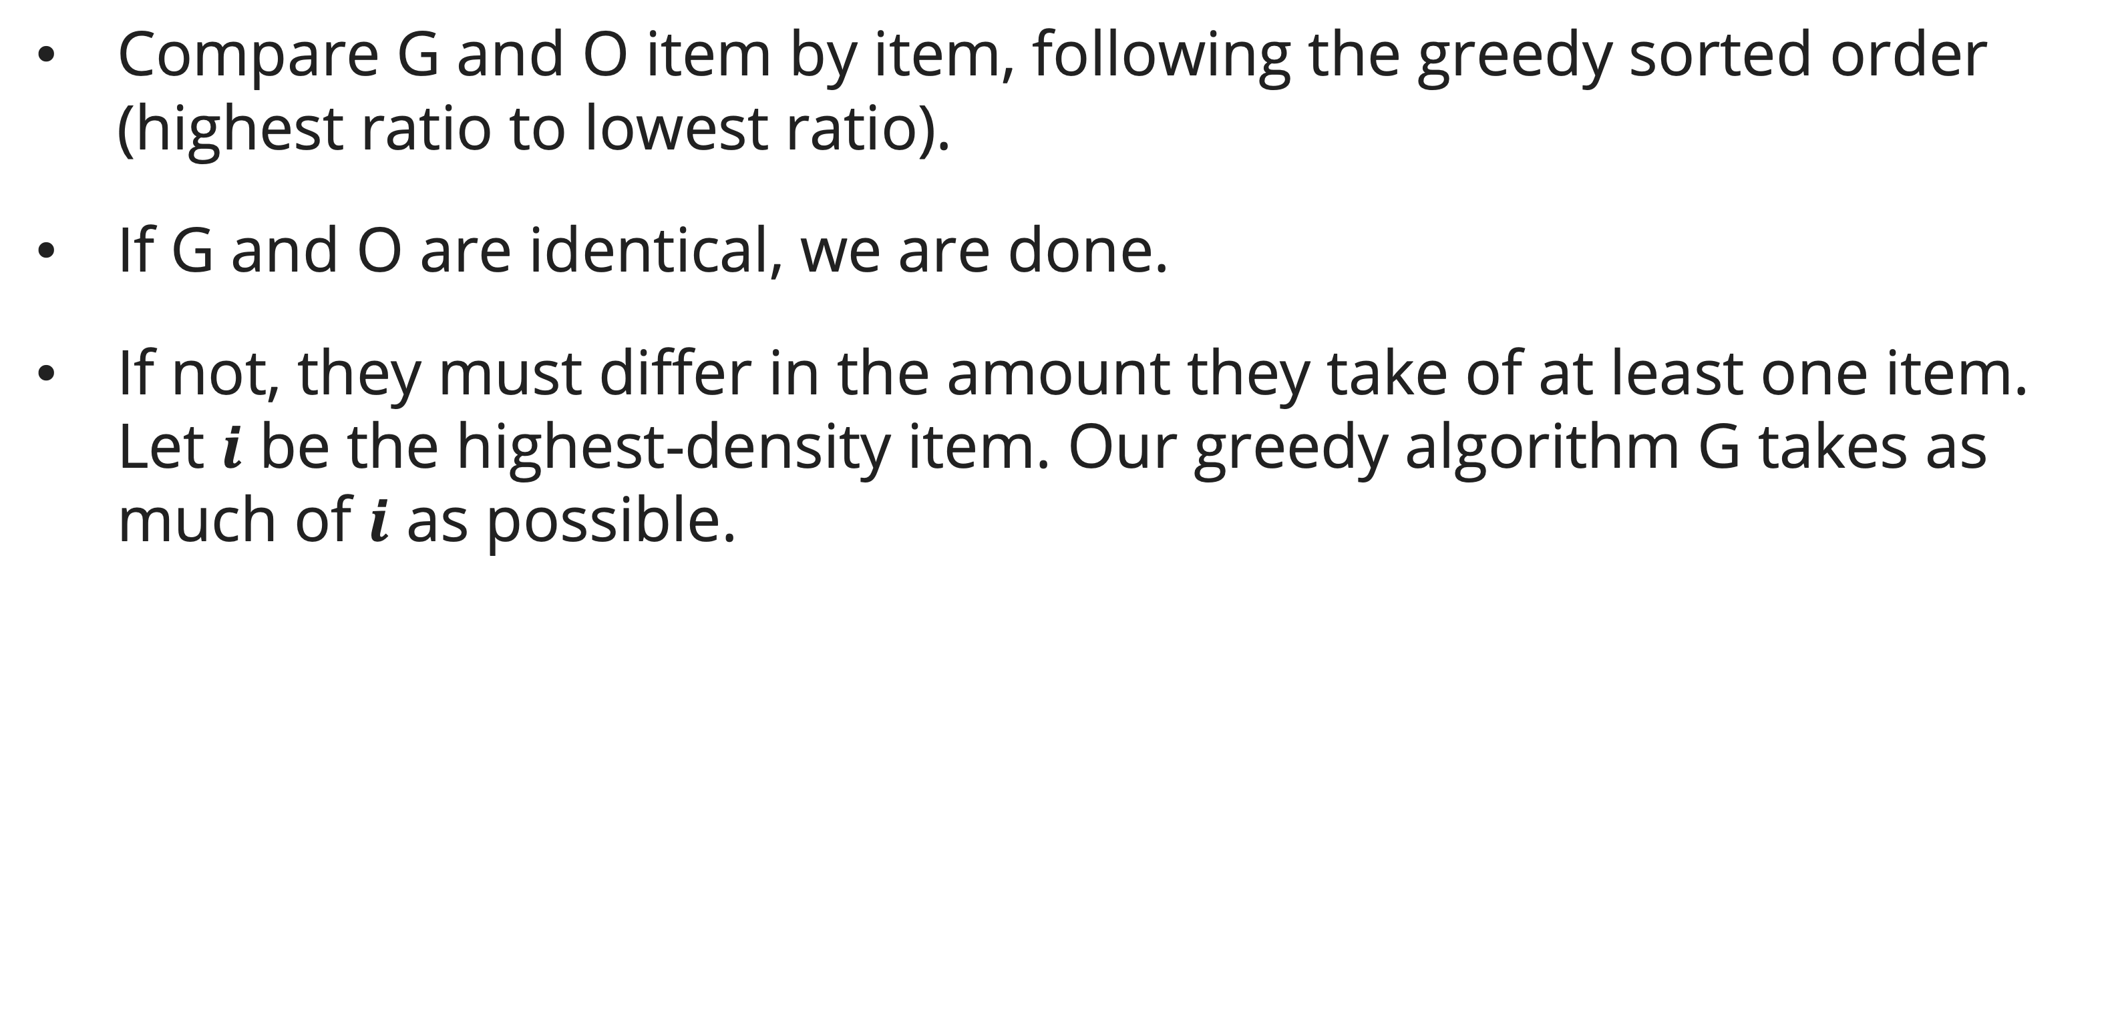
Fractional knapsack
Exchange argument: Step 2 – Find the First Difference
Compare G and O item by item, following the greedy sorted order (highest ratio to lowest ratio).
If G and O are identical, we are done.
If not, they must differ in the amount they take of at least one item. Let $i$ be the highest-density item. Our greedy algorithm G takes as much of $i$ as possible.

Slide 22
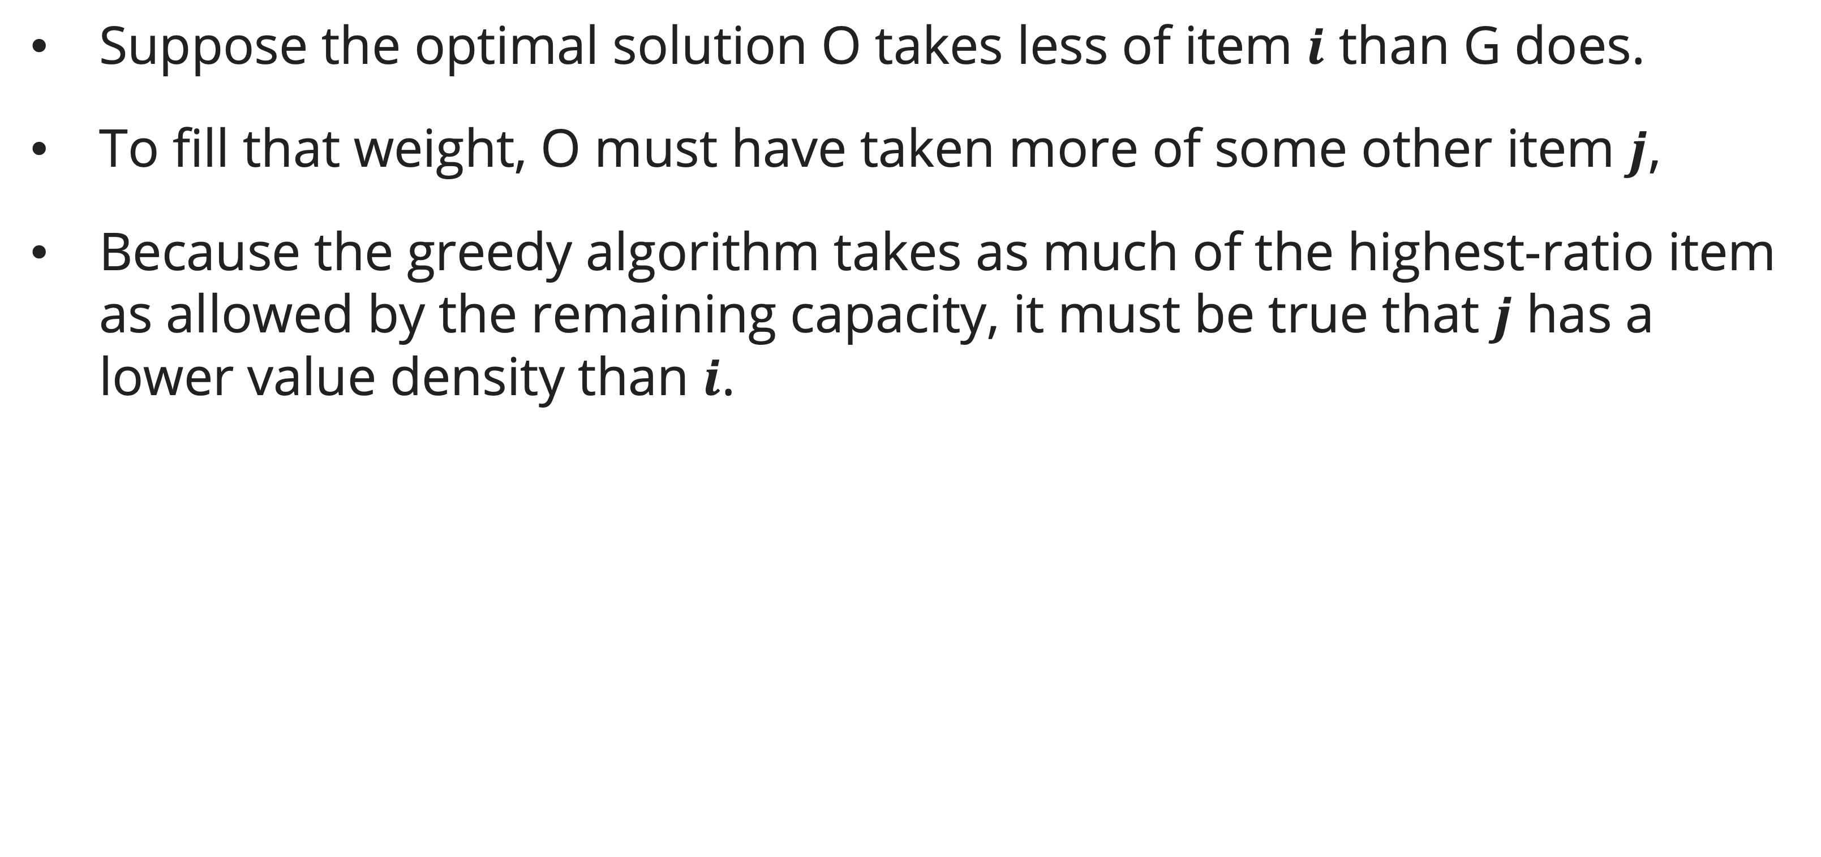
Fractional knapsack
Exchange argument: Step 3 – Identify the available substitute
Suppose the optimal solution O takes less of item $i$ than G does.
To fill that weight, O must have taken more of some other item $j$,
Because the greedy algorithm takes as much of the highest-ratio item as allowed by the remaining capacity, it must be true that $j$ has a lower value density than $i$.

Slide 23
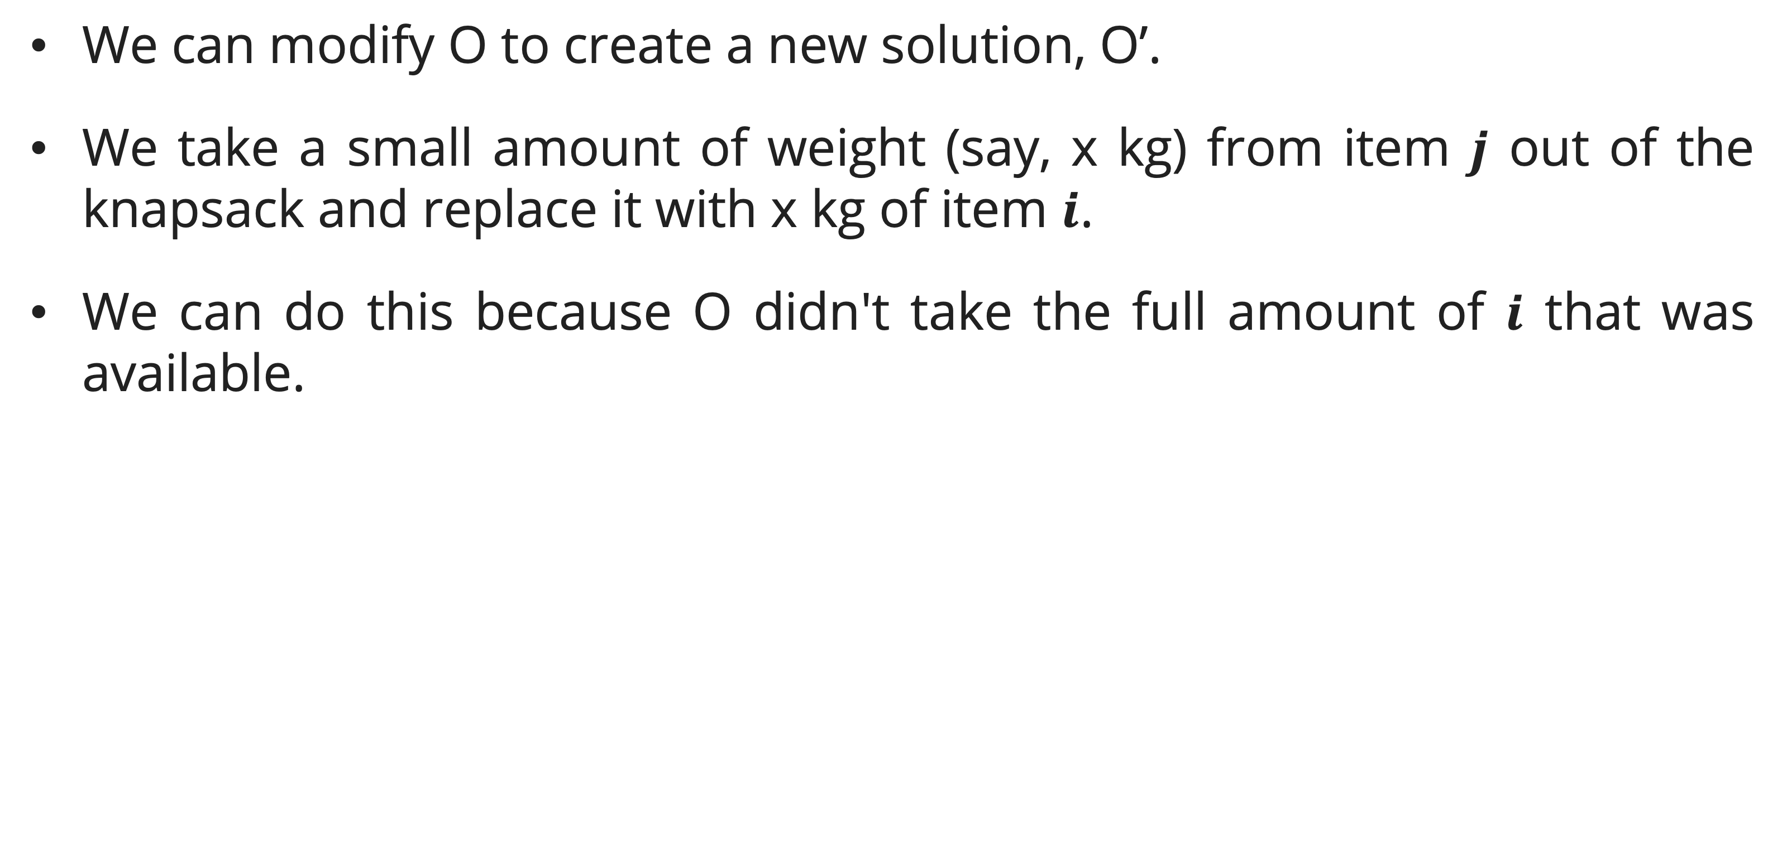
Fractional knapsack
Exchange argument: Step 4 – Do the exchange
We can modify O to create a new solution, O’.
We take a small amount of weight (say, x kg) from item $j$ out of the knapsack and replace it with x kg of item $i$.
We can do this because O didn't take the full amount of $i$ that was available.

Slide 24
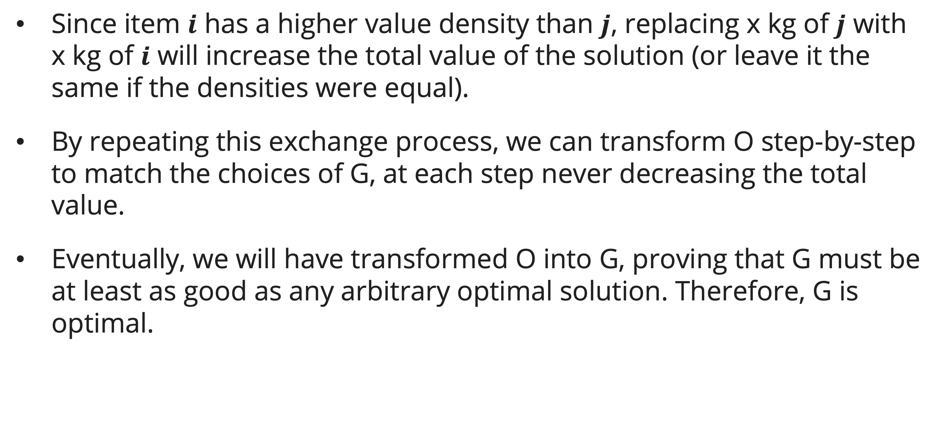
Fractional knapsack
Exchange argument: The result
Since item $i$ has a higher value density than $j$, replacing x kg of $j$ with x kg of $i$ will increase the total value of the solution (or leave it the same if the densities were equal).
By repeating this exchange process, we can transform O step-by-step to match the choices of G, at each step never decreasing the total value.
Eventually, we will have transformed O into G, proving that G must be at least as good as any arbitrary optimal solution. Therefore, G is optimal.

Slide 25
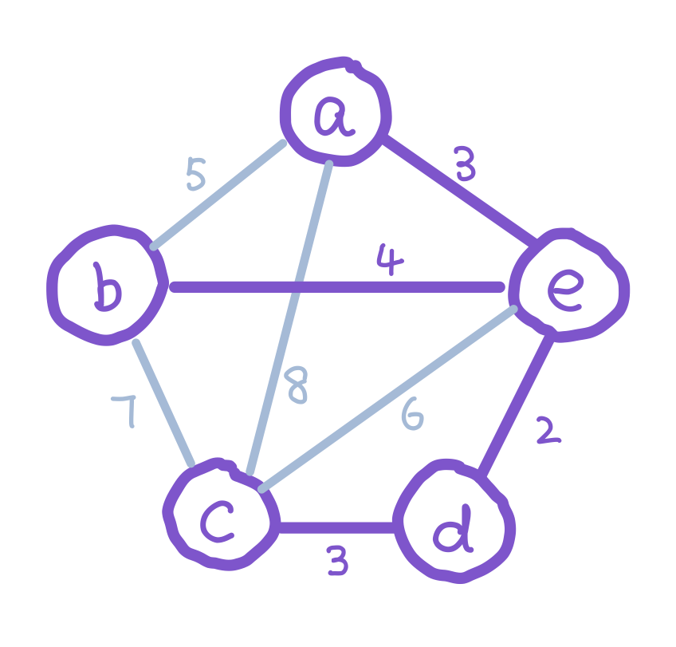
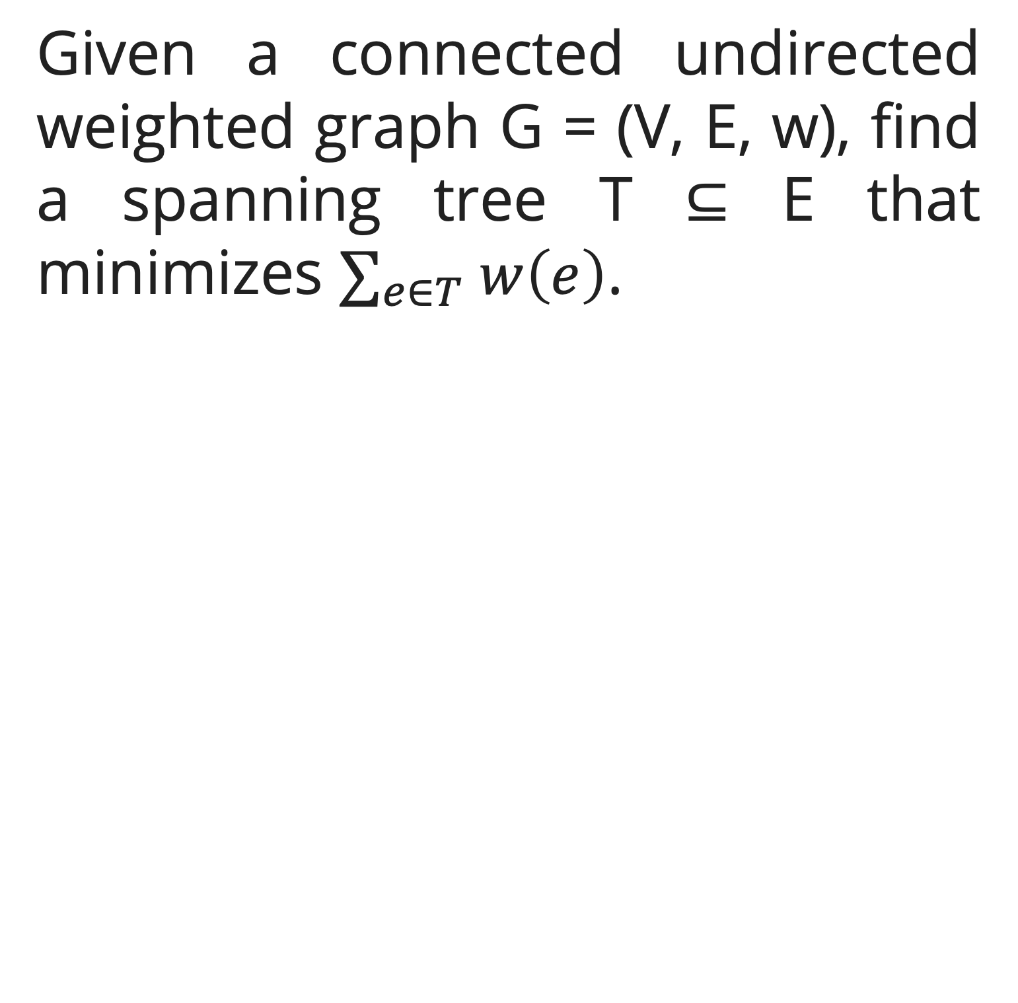
Minimum spanning tree (MST)
problem
Given a connected undirected weighted graph G = (V, E, w), find a spanning tree T ⊆ E that minimizes $∑_{e∈T} w\left(e\right)$.

Slide 26
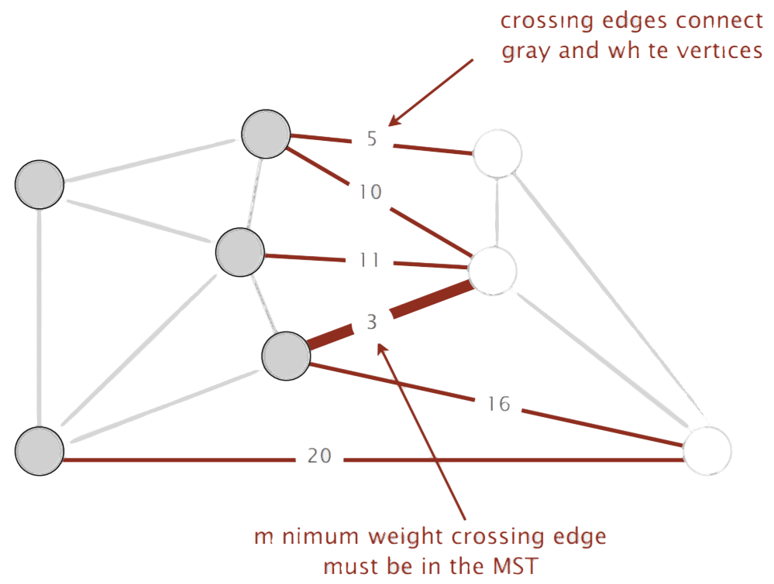
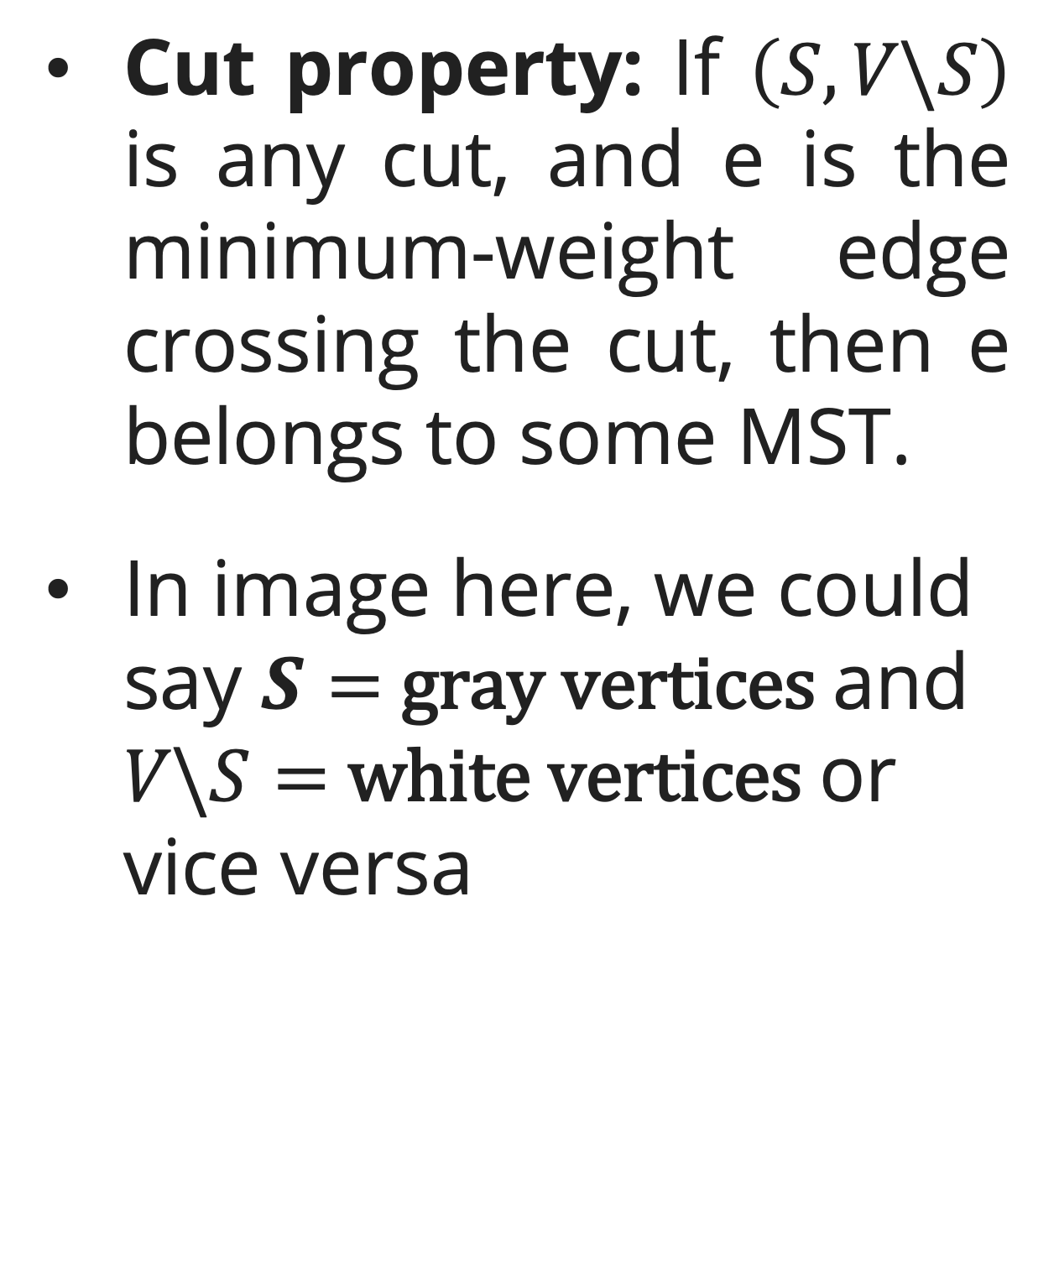
Minimum spanning tree (MST)
The cut property
Cut property: If $\left(S,V\backslash S\right)$ is any cut, and e is the minimum-weight edge crossing the cut, then e belongs to some MST.
In image here, we could say $S=$ gray vertices and $V\backslash S=$ white vertices or vice versa

Slide 27
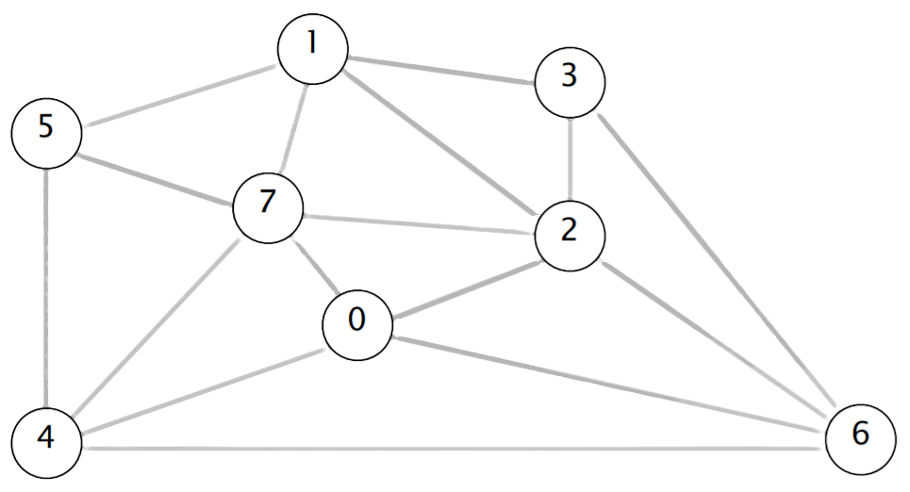
Minimum spanning tree (MST)
The cut property
One way to see the cut property in action is to imagine a small example.
Suppose we’ve almost found our minimum spanning tree, except for the vertex labelled 6 in the graph here.

Slide 28
Minimum spanning tree (MST)
The cut property
The only way to get to the vertex labelled 6 is using one of the four edges: (3, 6), (2, 6), (0, 6), or (4, 6).
A minimum spanning tree must choose a minimum-weight edge among the four options.

Slide 29
Minimum spanning tree (MST)
The cut property: insight
We can also design an algorithm for finding the minimum spanning tree based on this insight by working backwards from this idea.
Suppose we start from scratch in the same graph before.
If we (arbitrarily) choose to start at the vertex labelled 6, then the cut property tells us that we must choose a minimum-weight edge among the four options.
This is the basis of Prim’s algorithm for finding a minimum spanning tree.

Slide 30
Minimum spanning tree (MST)
Generic mst algorithm
All MST algorithms maintain a safe edge set A ⊆ MST:
GENERIC-MST(G, w)
A = {}
while A does not form a spanning tree
find a safe edge (u, v) for A
A = A ∪ {(u, v)}
return A

Slide 31
Minimum spanning tree (MST)
Generic mst algorithm: Exchange argument
The logic:
  Take an arbitrary MST T (Optimal Solution)
  Convert it into the algorithm’s output G by repeated exchange
  Each exchange keeps T a spanning tree without increasing its weight.

Slide 32
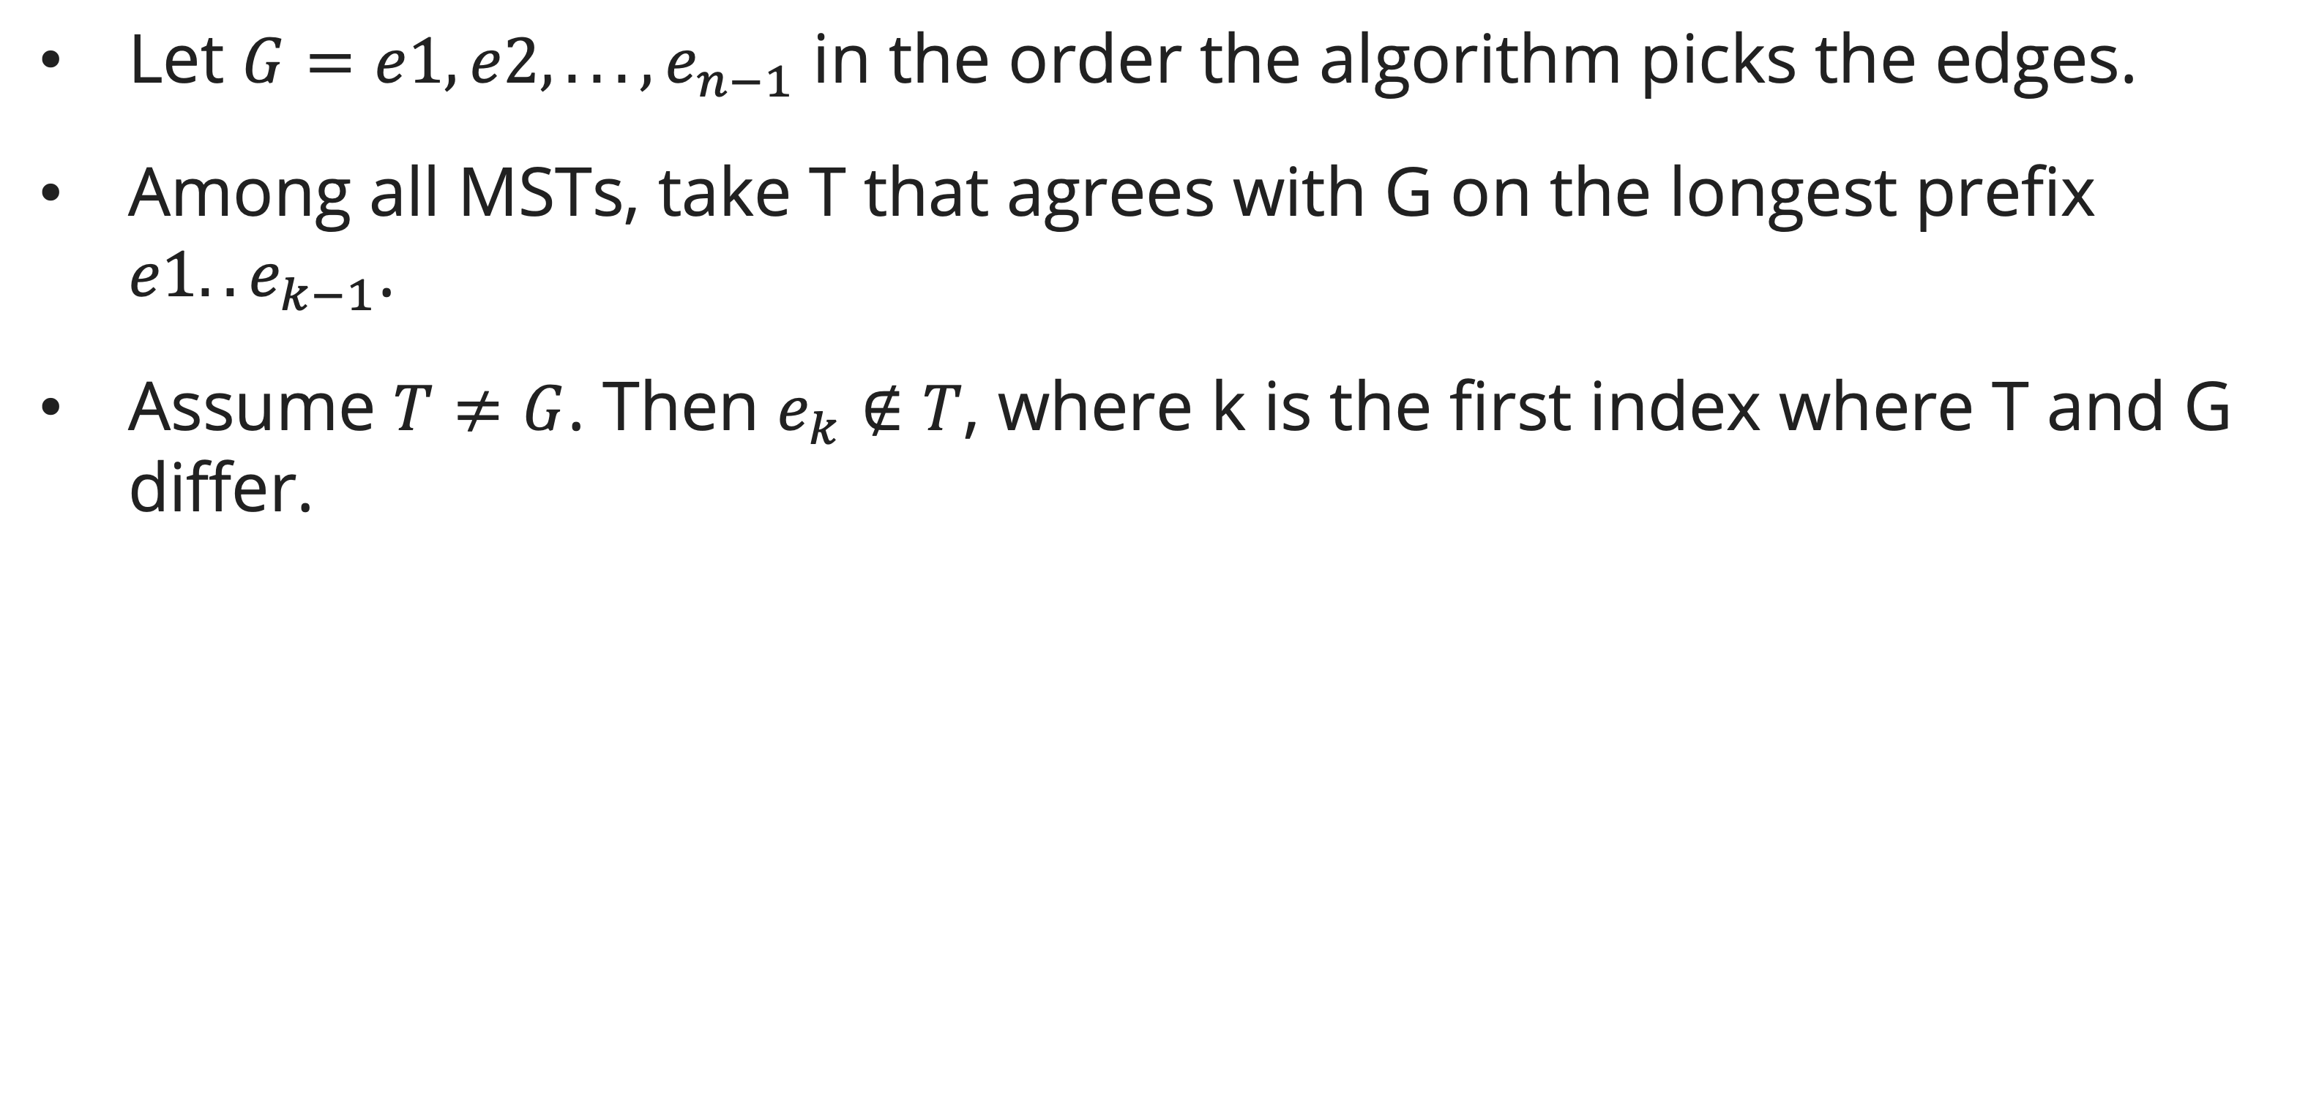
Minimum spanning tree (MST)
Generic mst algorithm: Exchange argument – Find The difference
Let $G=e1,e2,...,e_{n−1}$ in the order the algorithm picks the edges.
Among all MSTs, take T that agrees with G on the longest prefix $e1..e_{k−1}$.
Assume $T≠G$. Then $e_{k}∉T$, where k is the first index where T and G differ.

Slide 33
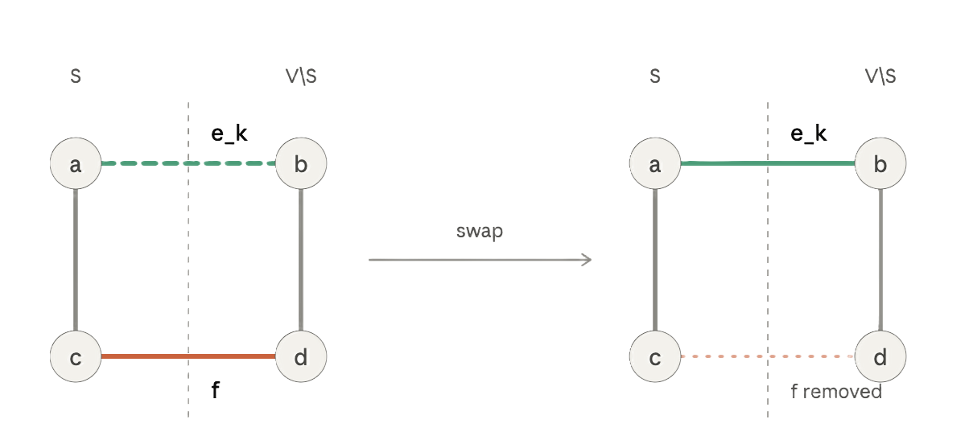
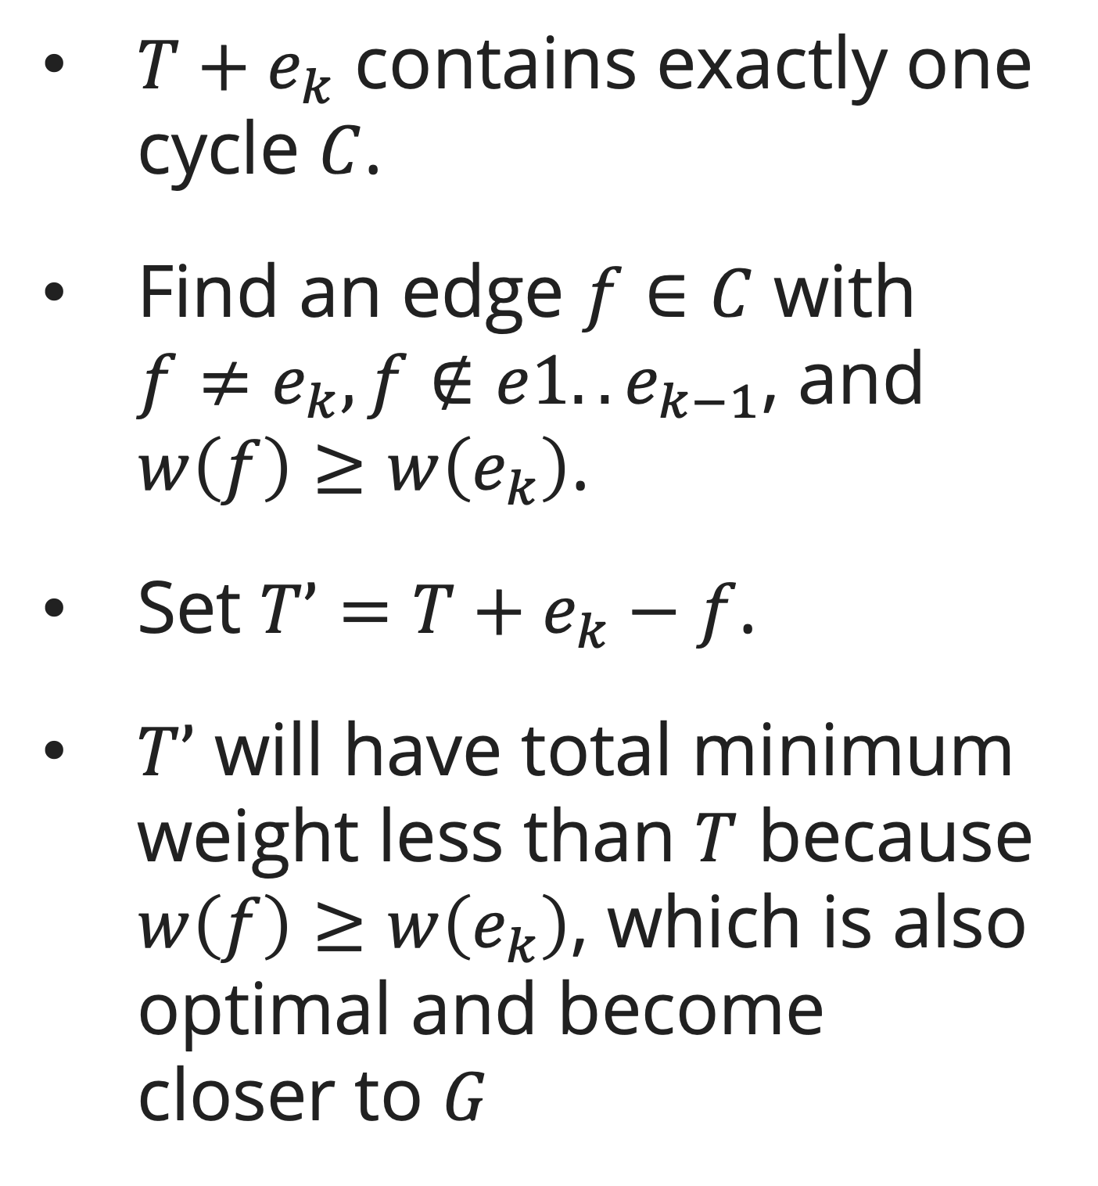


Minimum spanning tree (MST)
Generic mst algorithm: Exchange argument – Find The Substitute and Exchange
$T+e_{k}$ contains exactly one cycle $C$.
Find an edge $f∈C$ with $f≠e_{k},f∉e1..e_{k−1}$, and $w\left(f\right)≥w\left(e_{k}\right)$.
Set $T’=T+e_{k}−f$.
$T’$ will have total minimum weight less than $T$ because $w\left(f\right)≥w\left(e_{k}\right)$, which is also optimal and become closer to $G$
$$T+e_{k}:one cycle$$
$$T+e_{k}−f$$

Slide 34
Minimum spanning tree (MST)
Prim’s algorithm
Grow one tree greedily: always add the minimum-weight edge connecting the tree to a non-tree vertex.
Time: O((V + E) log V) with a binary min-heap; O(E + V log V) with a Fibonacci heap.
PRIM(G, w, r)
for each u ∈ V: key[u] = ∞; π[u] = NIL
key[r] = 0
Q = min-priority queue of V by key
while Q ≠ {}
u = EXTRACT-MIN(Q)
for each v adjacent to u
if v ∈ Q and w(u,v) < key[v]
π[v] = u; key[v] = w(u,v)
DECREASE-KEY(Q, v, w(u,v))

Slide 35
Minimum spanning tree (MST)
Kruskal’s algorithm
Sort edges by weight; add edge if it does not create a cycle (use Union-Find).
Time: O(E log E) = O(E log V) — dominated by sorting.
Correctness: Each added edge crosses a cut and is minimum weight crossing that cut → safe edge by cut property.
KRUSKAL(G, w)
A = {}
for each vertex v: MAKE-SET(v)
sort edges by weight
for each edge (u, v) in sorted order
if FIND-SET(u) ≠ FIND-SET(v)
A = A ∪ {(u, v)}
UNION(u, v)
return A

Slide 36
Dijkstra’s shortest path
problem
Single-source shortest path: given G = (V, E, w) with non-negative weights and source s, find shortest path from s to every other vertex.

Slide 37
Dijkstra’s shortest path
algorithm
Greedy: always relax the vertex with the smallest tentative distance.
DIJKSTRA(G, w, s)
for each v: d[v] = ∞; π[v] = NIL
d[s] = 0
Q = min-priority queue of V by d
while Q ≠ {}
u = EXTRACT-MIN(Q)
for each v adjacent to u
RELAX(u, v, w)
RELAX(u, v, w)
if d[v] > d[u] + w(u,v)
d[v] = d[u] + w(u,v)
π[v] = u
DECREASE-KEY(Q, v, d[v])
Time: O((V + E) log V) with binary heap; O(E + V log V) with Fibonacci heap.
Correctness: When a vertex u is extracted from Q, d[u] is final. Proven by induction using the non-negative weight assumption.
Limitation: Does not work with negative-weight edges. Use Bellman-Ford (Session 20).

Slide 38
Dijkstra’s shortest path
Dijkstra vs. Prim Comparison
Both algorithms are structurally identical — the only difference is the key update rule:
Prim: key[v] = minimum edge weight from tree to v.
Dijkstra: d[v] = minimum total path distance from source to v.

Slide 39
Summary
Session 11
Greedy works when the problem has the greedy-choice property and optimal substructure.
Fractional Knapsack: sort by value density; O(n log n). Greedy fails for 0/1 Knapsack.
Prim's: grow tree using min-heap → O(E log V) with binary heap.
Kruskal's: sort edges + Union-Find → O(E log V).
Dijkstra's: single-source shortest path with non-negative weights → O(E log V); analogous to Prim's.

Slide 40
Exercises
Session 11
Run Kruskal's algorithm on: V={A,B,C,D,E}, edges with weights: AB=1, AC=4, BC=2, BD=5, CD=3, DE=6, CE=1. Show the MST.
Run Dijkstra's algorithm from source A on the same graph. Show d[] and π[] after each EXTRACT-MIN.
Give a 0/1 knapsack instance where the fractional greedy algorithm gives the wrong answer.
Create the exchange argument for Dijkstra Algorithm! Identify the Optimal Solution, Substitute, Exchange and why it works!
What is the difference in time complexity between Kruskal's and Prim's for (a) a sparse graph E=O(V) and (b) a dense graph E=O(V²)?

Slide 41
References
Session 11
Primary (Required): Cormen, T.H., Leiserson, C.E., Rivest, R.L., & Stein, C. (2022). Introduction to Algorithms, 4th Edition. MIT Press.
Ch. 15.2 — Elements of the Greedy Strategy (p. 426)
Ch. 19.1–19.3 — Disjoint-Set Operations and Forests (p. 520–527)
Ch. 21.1–21.2 — Minimum Spanning Trees, Kruskal and Prim (p. 586–591)
Ch. 22.3 — Dijkstra's Algorithm (p. 620)
Secondary (Required): Skiena, S.S. (2020). The Algorithm Design Manual, 3rd Edition. Springer.
Ch. 8.1 — Minimum Spanning Trees (p. 244)
Ch. 8.3.1 — Dijkstra's Algorithm (p. 258)
Ch. 16.10 — Knapsack Problem (p. 497)

